Slide 1

Near(est) Neighbor Search in High Dimensions
Piotr Indyk
MIT

Slide 2
Nearest Neighbor Search
Given: a set P of n points in R^{d}
Nearest Neighbor: for any query q, returns a point p∈P minimizing ||p-q||
r-Near Neighbor: for any query q, returns a point p∈P s.t.
||p-q|| ≤ r (if it exists)
r
q

Slide 3
High-dimensional near(est) neighbor: applications
Machine learning: nearest neighbor rule
  Find the closest example with known class
  Copy the class label
Near-duplicate Retrieval
?
Dimension=number of pixels
To be or not to be …
(... , 1, …, 4, … , 2 , …, 2, …)
(... , 6, …, 1, … , 3 , …, 6, …)
(... , 1, …, 3, … , 7 , …, 5, …)
(... , 2, …, 2, … , 1 , …, 1, …)
Dimension=number of words
Notes:
Flip examples; mention videos

Slide 4
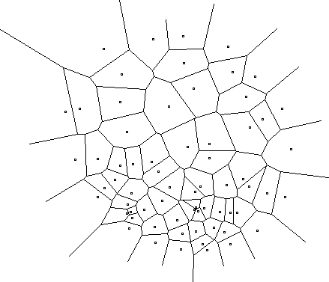
The case of d=2
Compute Voronoi diagram
Given q, perform point location
Performance:
  Space: O(n)
  Query time: O(log n)

Slide 5
The case of d>2
Voronoi diagram has size n^{[d/2]}
  [Dobkin-Lipton’78,Meiser’93,Clarkson’88]:
  n^{O(d)} space, (d+ log n)^{O(1)} time
We can also perform a linear scan: O(dn) space and time
  Can speedup the scan by roughly O(n^{1/d})
These are pretty much the only known general solutions !
  Kd-trees, Cover Trees, LSH, Spill trees, etc all denegerate to one of the two extremes in the worst case
In fact:
  If there was an algorithm that performs n queries in O(dn^{1+α} ) time for α<1 (incl. preprocessing)
  Then there would be an algorithm solving satisfiability in (slightly) sub-exponential time [Williams’04]

Slide 6
Approximate Nearest Neighbor
c-Approximate Nearest Neighbor: build data structure which, for any query q
  returns p’∈P, ||p-q|| ≤ cr,
  where r is the distance to the nearest neighbor of q
r
q
cr

Slide 7
Approximate Near Neighbor
c-Approximate r-Near Neighbor: build data structure which, for any query q:
  If there is a point p∈P, ||p-q|| ≤ r
  it returns p’∈P, ||p-q|| ≤ cr
Most algorithms randomized:
  For each query q, the probability (over the randomness used to construct the data structure) is at least 90%
r
q
cr

Slide 8
Approximate algorithms
Space/time exponential in d [Arya-Mount’93],[Clarkson’94], [Arya-Mount-Netanyahu-Silverman-Wu’98] [Kleinberg’97], [Har-Peled’02], ….
Space/time polynomial in d [Indyk-Motwani’98], [Kushilevitz-Ostrovsky-Rabani’98], [Indyk’98], [Gionis-Indyk-Motwani’99], [Charikar’02], [Datar-Immorlica-Indyk-Mirrokni’04], [Chakrabarti-Regev’04], [Panigrahy’06], [Ailon-Chazelle’06], [Andoni-Indyk’06],…., [Andoni-Indyk-Nguyen-Razenshteyn’14], [Andoni-Razenshteyn’15]
Space | Time | Comment | Norm | Ref
dn+n^{O(1/ε2)} | d * logn /ε² (or 1) | c=1+ ε | Hamm, l₂ | [KOR’98, IM’98]
n^{Ω(1/ε2)} | O(1) |  |  | [AIP’06]
dn+n^{1+ρ(c)} | dn^{ρ(c)} | ρ(c)=1/c | Hamm, l₂ | [IM’98], [GIM’98],[Cha’02]
 |  | ρ(c)<1/c | l₂ | [DIIM’04]
 |  | ρ(c)=1/c² + o(1) | l₂ | [AI’06]
 |  | ρ(c)= (7/8)/c² + o(1/c³) | l₂ | [AINR’14]
 |  | ρ(c)= 1/(2c²-1)+o(1) | l₂ | [AR’15]
dn * logs | dn^{σ(c)} | σ(c)=O(1/c) | l₂ | [Panigrahy’06]
 |  | σ(c)=O(1/c²) | l₂ | [AI’06]

Slide 9
Approximate Near Neighbor Algorithms
In this talk we focus on:
  Euclidean norm
  Polynomial dependence on dimension
  Near-linear space: dn+n^{1+ρ(c)} , ρ(c)<1
  Sub-linear query time: dn^{ρ(c)}
ρ(2)
0.5
0.45
0.25
0.14
1998
2004
2006
2014
2015
Year

Slide 10
LSH
A family H of functions h: R^{d} → U is called (P₁,P₂,r,cr)-sensitive for distance D, if for any p,q:
  If D(p,q) <r then Pr[ h(p)=h(q) ] > P₁
  If D(p,q) >cr then Pr[ h(p)=h(q) ] < P₂
Example: Hamming distance
  h(p)=p_{i}, i.e., the i-th bit of p
    Probabilities: Pr[ h(p)=h(q) ] = 1-D(p,q)/d
p=10010010
q=11010110

Slide 11
Algorithm
We use functions of the form
g(p)=<h₁(p),h₂(p),…,h_{k}(p)>
Preprocessing:
  Select g₁…g_{L} independently at random
  For all p∈P, hash p to buckets g₁(p)…g_{L}(p)
Query:
  Retrieve the points from buckets g₁(q), g₂(q), … , until
    Either the points from all L buckets have been retrieved, or
    Total number of points retrieved exceeds 3L
  Answer the query based on the retrieved points
  Total time: O(dL)

Slide 12
Analysis
Lemma1: the algorithm solves c-approximate NN with:
  Number of hash functions:
  L=C n^{ρ}, ρ=log(1/P1)/log(1/P2)
  (C=C(P1,P2) is a constant for P1 bounded away from 0)
  Constant success probability for a fixed query q
Lemma 2: for Hamming LSH functions, we have ρ=1/c

Slide 13
Proof
Define:
  p: a point such that ||p-q|| ≤ r
  FAR(q)={ p’∈P: ||p’-q|| >c r }
  B_{i}(q)={ p’∈P: g_{i}(p’)=g_{i}(q) }
Will show that both events occur with >0 probability:
  E₁: g_{i}(p)=g_{i}(q) for some i=1…L
  E₂: Σ_{i} |B_{i}(q) ∩ FAR(q)| < 3L

Slide 14
Proof ctd.
Set k= ceil(log_{1/P2} n)
For p’∈FAR(q) ,
Pr[g_{i}(p’)=g_{i}(q)] ≤ P₂^{k} ≤1/n
E[ |B_{i}(q)∩FAR(q)| ] ≤ 1
E[Σ_{i} |B_{i}(q)∩FAR(q)| ] ≤ L
Pr[Σ_{i} |B_{i}(q)∩FAR(q)|≥3L ] ≤ 1/3

Slide 15
Proof, ctd.
Pr[ g_{i}(p)=g_{i}(q) ] ≥ 1/P₁^{k} ≥ P₁ ^{log1/P2 (n)+1}
≥ 1/(P1 n^{ρ})=1/L
Pr[ g_{i}(p)≠g_{i}(q), i=1..L] ≤ (1-1/L)^{L} ≤ 1/e

Slide 16
Proof, end
Pr[E₁ not true]+Pr[E₂ not true]
≤ 1/3+1/e =0.7012.
Pr[ E₁ ∩ E₂ ] ≥ 1-(1/3+1/e) ≈0.3

Slide 17
Proof of Lemma 2
Statement: for
  P1=1-r/d
  P2=1-cr/d
we have ρ=log(P1)/log(P2) ≤ 1/c
Proof:
  Need P1^{c} ≥ P2
  But (1-x)^{c} ≥ (1-cx) for any 1>x>0, c>1

Slide 18
Recap
LSH solves c-approximate NN with:
  Number of hash fun: L=O(n^{ρ}), ρ=log(1/P1)/log(1/P2)
  For Hamming distance we have ρ=1/c
Questions:
  Beyond Hamming distance ?
  Reduce the exponent ρ ?

Slide 19
Random Projection LSH for L₂
[Datar-Immorlica-Indyk-Mirrokni’04]
Define h_{X,b}(p)=⎣(p*X+b)/w⎦:
  w ≈ r
  X=(X₁…X_{d}) , where X_{i} are i.i.d. random variables chosen from Gaussian distribution
  b is a scalar chosen uniformly at random from [0,w]
^{p}
X
w
w

Slide 20
Analysis
Need to:
  Compute Pr[h(p)=h(q)] as a function of ||p-q|| and w; this defines P₁ and P₂
  For each c choose w that minimizes
  ρ=log_{1/P2}(1/P₁)
w
w

Slide 21
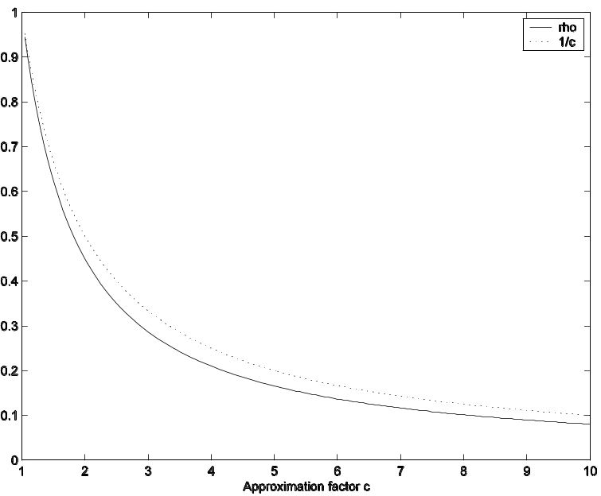
ρ(c) for l₂
Improvement not dramatic
But the hash function very simple and works directly in l₂

Slide 22
Ball lattice hashing
[Andoni-Indyk’06]
Instead of projecting onto R¹,
project onto R^{t} , for constant t
Intervals → lattice of balls
  Can hit empty space, so hash until a ball is hit
Analysis:
  ρ=1/c² + O( log t / t^{1/2} )
  Time to hash is t^{O(t)}
  Total query time: dn^{1/c2+o(1)}
[Motwani-Naor-Panigrahy’06]: LSH in l₂ must have ρ ≥ 0.45/c²
[O’Donnell-Wu-Zhou’09]:
ρ ≥ 1/c² – o(1)
^{p}
X
w
w
^{p}

Slide 23
Data-dependent hashing [Andoni-Razenshteyn’15]
The aforementioned LSH schemes are optimal for data oblivious hashing
  Select g₁…g_{L} independently at random
  For all p∈P, hash p to buckets g₁(p)…g_{L}(p)
  Retrieve the points from buckets g₁(q), g₂(q), …
The new schemes are data dependent
  If the points are “random”, can prove better bound
  If the points are not “random”, cluster and recurse
Improve exponent from 1/c² to 1/(2c²-1)

Slide 24
LSH Zoo
Have seen:
  Hamming metric: projecting on coordinates
  L₂ :random projection+quantization
Other (provable):
  L₁ norm: random shifted grid [Andoni-Indyk’05] (cf. [Bern’93])
  Vector angle [Charikar’02] based on [Goemans-Williamson’94]
  Jaccard coefficient [Broder’97]
J(A,B) = |A ∩ B| / |A u B|
Other (empirical): inscribed polytopes [Terasawa-Tanaka’07], orthogonal partition [Neylon’10]
Other (applied): semantic hashing, spectral hashing, kernelized LSH, Laplacian co-hashing, , BoostSSC, WTA hashing,…

Slide 25
Min-wise hashing
[Broder’97, Broder-Charikar-Frieze-Mitzenmacher’98]
In many applications, the vectors tend to be quite sparse (high dimension, very few 1’s)
Easier to think about them as sets
For two sets A,B, define the Jaccard coefficient:
J(A,B)=|A ∩ B|/|A U B|
  If A=B then J(A,B)=1
  If A,B disjoint then J(A,B)=0
Can we design LSH families for J(A,B) ?

Slide 26
Hashing
Mapping:
g(A)=min_{a∈A} h(a)
where h is a random permutation of the elements in the universe
Fact: Pr[g(A)=g(B)]=J(A,B)
Proof: Where is min( h(A) U h(B) ) ?
A
B

Slide 27
Random hyperplane
[Goemans-Williamson’94, Charikar’02]
Let u,v be unit vectors in R^{m}
Angular distance:
A(u,v)=angle between u and v
Hashing:
  Choose a random unit vector r
  Define s(u)=sign(u*r)

Slide 28
Probabilities
What is the probability of
sign(u*r)≠sign(v*r) ?
It is A(u,v)/π
u
A(x,y)
v

Slide 29
New LSH scheme, ctd.
How does it work in practice ?
The time t^{O(t)}dn^{1/c2+f(t)} is not very practical
  Need t≈30 to see some improvement
Idea: a different decomposition of R^{t}
  Replace random balls by Voronoi diagram of a lattice
  For specific lattices, finding a cell containing a point can be very fast →fast hashing

Slide 30
Leech Lattice LSH
Use Leech lattice in R²⁴ , t=24
  Largest kissing number in 24D: 196560
  Conjectured largest packing density in 24D
  24 is 42 in reverse…
Very fast (bounded) decoder: about 519 operations [Amrani-Beery’94]
Performance of that decoder for c=2:
  1/c² 0.25
  1/c 0.50
  Leech LSH, any dimension: ρ ≈ 0.36
  Leech LSH, 24D (no projection): ρ ≈ 0.26

