Slide 1
CS 121: Lecture 11 More on Turing Machines
Madhu Sudan
https://madhu.seas.Harvard.edu/courses/Fall2020
Book: https://introtcs.org
{
The whole staff (faster response): CS 121 Piazza
How to contact us
Only the course heads (slower): cs121.fall2020.course.heads@gmail.com

Slide 2
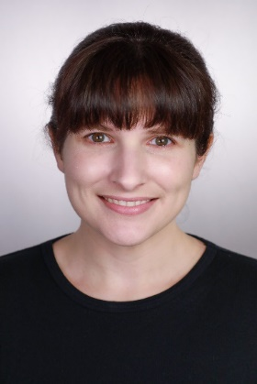
Announcements:
Advanced Sections: Christina Ilvento on Differential Privacy!
Homework 3 due today.
Sample midterm available for tech/TeX/rules.
Actual Midterm:
Pick up on Canvas;
TeX your answers ;
Submit on Gradescope-submit your answers like a problem set.
Section: no video this week; review for midterm.
Section on Turing Machines: next week.
Midterm review materials:
Diego/Joanna’s handout
Past midterms: two on finite automata without solutions; several from Boaz with solutions.

Slide 3
Where we are:
✓
Part I: Circuits:
Finite computation,
quantitative study
✓
Part II: Automata:
Infinite restricted computation, quantitative study
Part III: Turing Machines:
Infinite computation, qualitative study
Part IV: Efficient Computation:
Infinite computation, quantitative study
Part V: Randomized computation:
Extending studies to non-classical algorithms

Slide 4
Today:
Part 1: More examples of Turing Machines
TM to compute $PAL:{\left\{0,1\right\}}^{∗}→\left\{0,1\right\}$ where $PAL\left(x\right)=1⇔x=x^{R}$
TM to compute $h:{\left\{0,1\right\}}^{∗}→{\left\{0,1\right\}}^{∗}$, where $h\left(x\right)=y$ where $x=yz$ and $\left|y\right|∈\left\{\left|z\right|, \left|z\right|+1\right\}$
Part 2: (Discussion) Looking to the future:
Computable functions.
Def (7.2 in Barak): Function computable $⇔$ computable by TM
Equivalence with other computing & non-computing models: Multiple tapes, RAM, $λ$-calculus, polynomials …

Slide 5
Recall Turing Machines
(Barak, Definition 7.1):
TM on $k$ states and alphabet $Σ⊇\left\{0,1,ω, φ\right\}$
is given by $δ:\left[k\right]×Σ→\left[k\right]×Σ×Action$,
where $Action=\left\{L,R,S,H\right\}$
$L$=Left, $R$=Right, $S$=Stay (don’t move), $H$=Halt (done!!)
Operation:
Start in state $0$, Tape $T=x_{0}…x_{n−1}φφφ…$ , Head $(i)$ at $x_{0}$
General step: current state $q$ ; input symbol $σ$:
Let $δ\left(q,σ\right)=\left(r,τ, X\right)⇒$ Write $τ$ on tape (overwriting $σ$) ; Move to state $r$; Move Head left ($i←i−1$) if $X=L$; right if $X=R$; don’t move if $X=S$.
Repeat General step until $X=H$

Slide 6
Recognizing Palindromes
$PAL:{\left\{0,1\right\}}^{∗}→\left\{0,1\right\}$ where $PAL\left(x\right)=1⇔x=x^{R}$
Overview/Idea:
Scan left to right between #s.
Replace extreme symbols by # if they match, Reject if they don’t
Till middle region is empty.

Slide 7

More details:
Alphabet: $Σ=\left\{0,1,ω, φ, \#\right\}$
States:
0: Start
1: Scan Right 0
2: Scan Right 1
3: Check 0
4: Check 1
5: Move Left
6: Accept and Halt
7: Reject and Clean Left

Slide 8
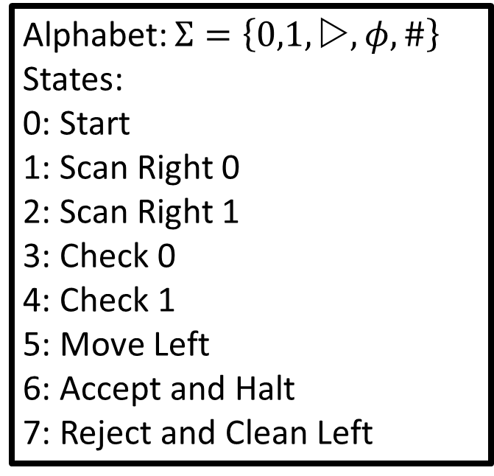
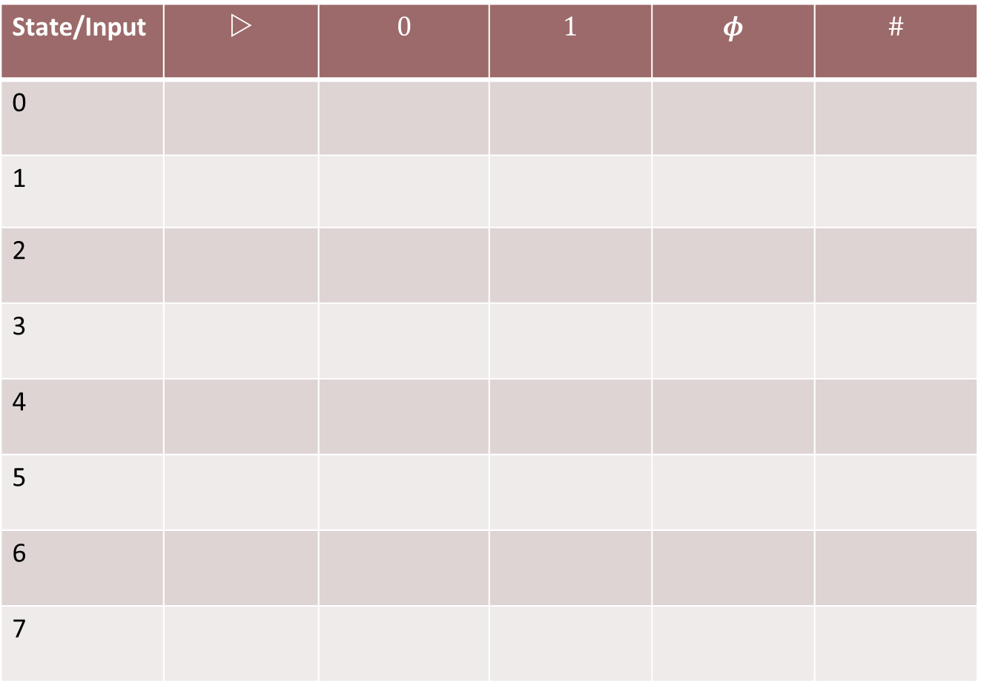
Alphabet: $Σ=\left\{0,1,ω, φ, \#\right\}$
States:
0: Start
1: Scan Right 0
2: Scan Right 1
3: Check 0
4: Check 1
5: Move Left
6: Accept and Halt
7: Reject and Clean Left
State/Input | $$$$ | $$0$$ | $$1$$ | $$φ$$ | $$\#$$
0
1
2
3
4
5
6
7

Slide 9
Alphabet: $Σ=\left\{0,1,ω, φ, \#\right\}$
States:
0: Start
1: Scan Right 0
2: Scan Right 1
3: Check 0
4: Check 1
5: Move Left
6: Accept and Halt
7: Reject and Clean Left

Slide 10
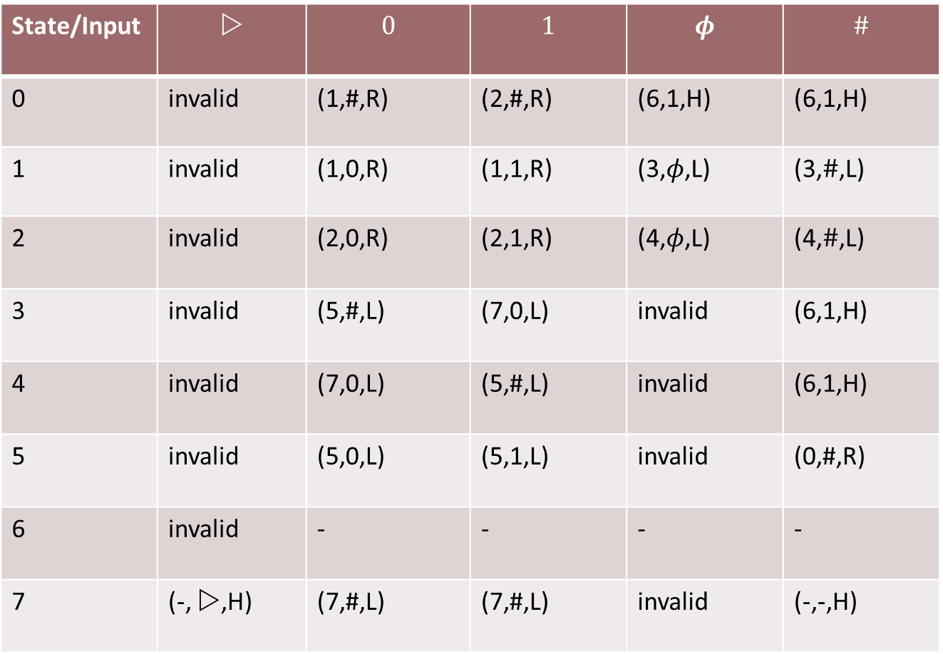
Alphabet: $Σ=\left\{0,1,ω, φ, \#\right\}$
States:
0: Start
1: Scan Right 0
2: Scan Right 1
3: Check 0
4: Check 1
5: Move Left
6: Accept and Halt
7: Reject and Clean Left
State/Input | $$$$ | $$0$$ | $$1$$ | $$φ$$ | $$\#$$
0 | invalid | (1,#,R) | (2,#,R) | (6,1,H) | (6,1,H)
1 | invalid | (1,0,R) | (1,1,R) | (3,$φ$,L) | (3,$\#$,L)
2 | invalid | (2,0,R) | (2,1,R) | (4,$φ$,L) | (4,$\#$,L)
3 | invalid | (5,#,L) | (7,0,L) | invalid | (6,1,H)
4 | invalid | (7,0,L) | (5,#,L) | invalid | (6,1,H)
5 | invalid | (5,0,L) | (5,1,L) | invalid | (0,#,R)
6 | invalid | - | - | - | -
7 | (-, $$,H) | (7,#,L) | (7,#,L) | invalid | (-,-,H)

Slide 11
Exercise Break 1
Design TM to compute $h:{\left\{0,1\right\}}^{∗}→{\left\{0,1\right\}}^{∗}$, where $h\left(x\right)=y$ where $x=yz$ and $\left|y\right|∈\left\{\left|z\right|, \left|z\right|+1\right\}$
Formulate your plan
Break from Break (Return from Break + Discuss Plan)
Choose your alphabet
Set up the states
Start thinking about key transitions

Slide 12

One solution:
Alphabet: $Σ=\left\{0,1,ω, φ, \#, \#_{0},\#_{1}\right\}$
States:
0: Start: Replace $b$ by $\#_{b}$
1: Zig Right
2. Erase last symbol
3. Zag Left

Slide 13
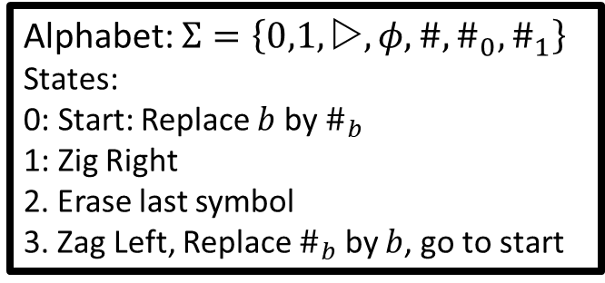
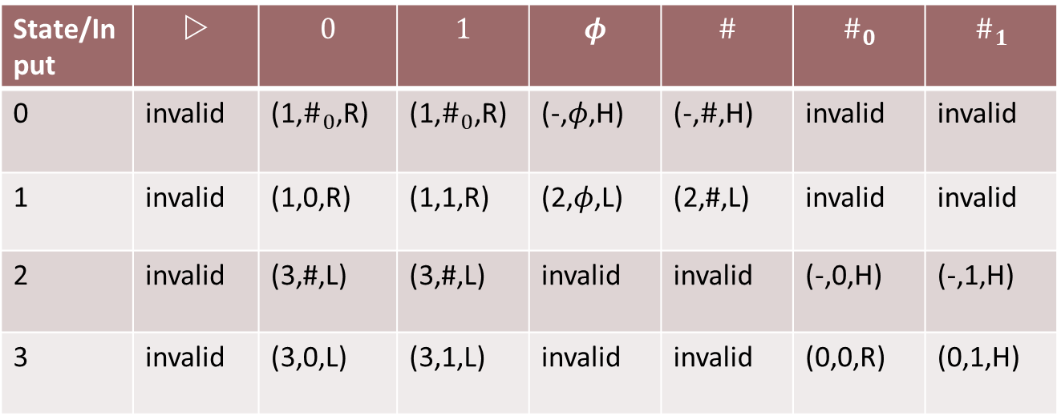
Alphabet: $Σ=\left\{0,1,ω, φ, \#, \#_{0},\#_{1}\right\}$
States:
0: Start: Replace $b$ by $\#_{b}$
1: Zig Right
2. Erase last symbol
3. Zag Left, Replace $\#_{b}$ by $b$, go to start
State/Input | $$$$ | $$0$$ | $$1$$ | $$φ$$ | $$\#$$ | $$\#_{0}$$ | $$\#_{1}$$
0 | invalid | (1,$\#_{0}$,R) | (1,$\#_{0}$,R) | (-,$φ$,H) | (-,$\#$,H) | invalid | invalid
1 | invalid | (1,0,R) | (1,1,R) | (2,$φ$,L) | (2,#,L) | invalid | invalid
2 | invalid | (3,#,L) | (3,#,L) | invalid | invalid | (-,0,H) | (-,1,H)
3 | invalid | (3,0,L) | (3,1,L) | invalid | invalid | (0,0,R) | (0,1,H)

Slide 14
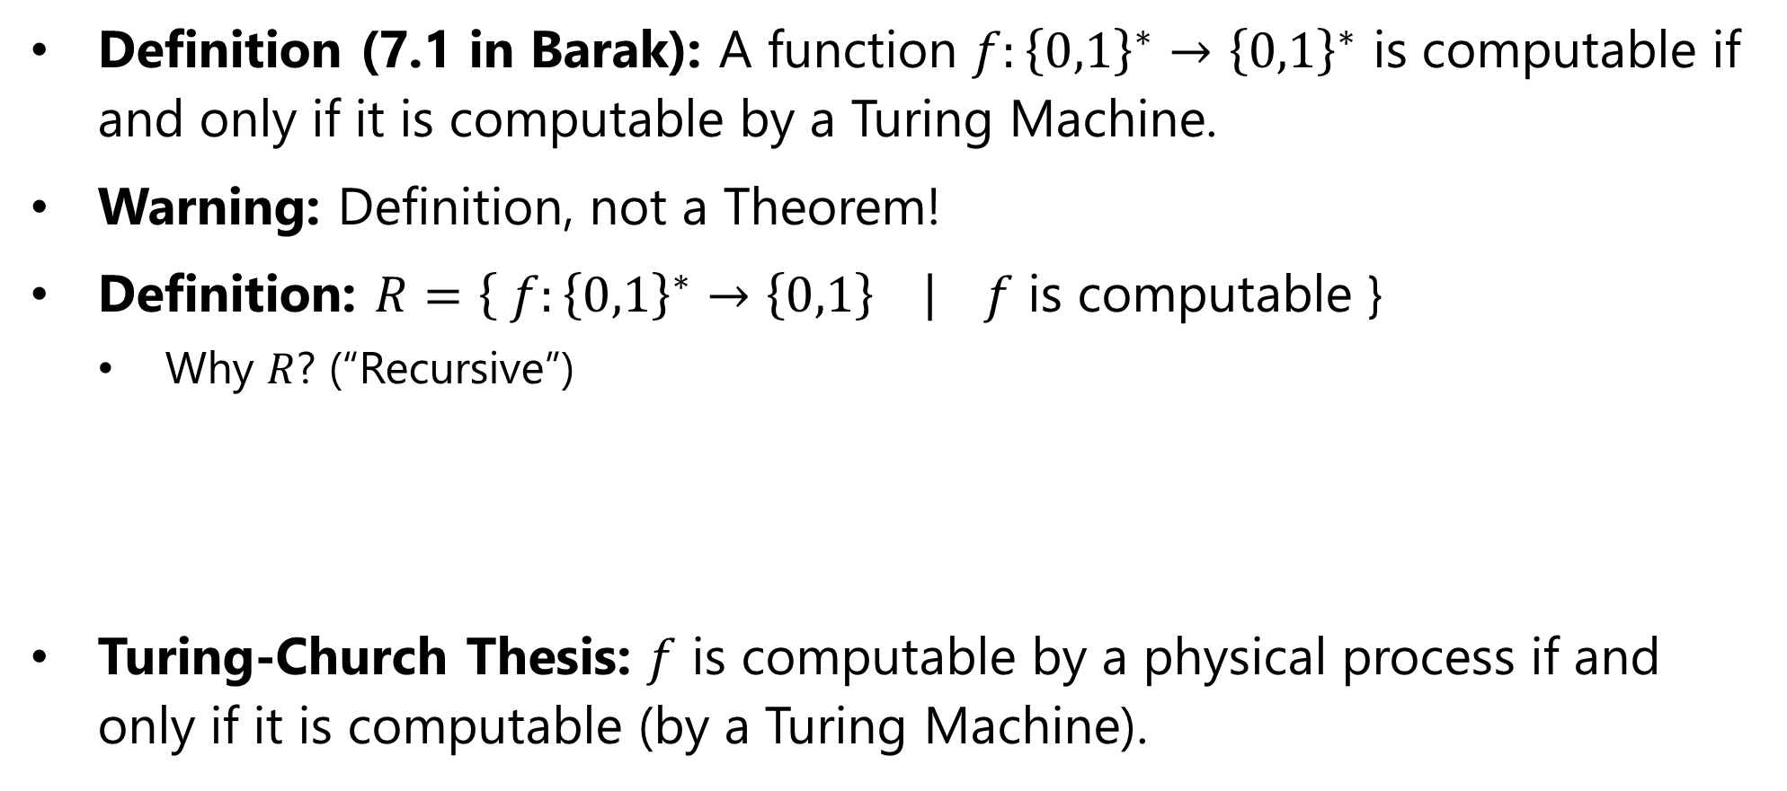
Computable Functions
Definition (7.1 in Barak): A function $f:{\left\{0,1\right\}}^{∗}→{\left\{0,1\right\}}^{∗}$ is computable if and only if it is computable by a Turing Machine.
Warning: Definition, not a Theorem!
Definition: $R=\left\{ f:{\left\{0,1\right\}}^{∗}→\left\{0,1\right\} \right| f$ is computable }
Why $R$? (“Recursive”)
Turing-Church Thesis: $f$ is computable by a physical process if and only if it is computable (by a Turing Machine).

Slide 15
In following lectures
Turing Equivalence
Turing machines can simulate other Turing Machines
With multiple tapes
With accept/reject states
With 1 tape and multiple heads
RAM programs: (Main diff: Can read Tape[i] and then Tape[3$i$+25] in O(1) steps.
High-level programs – C++, Python …
Rewrite systems; $Λ$-Calculus ; Hilbert Problem
Universal TMs: TM that takes other TMs as input and runs them!
Uncomputability … the bane of computing.

