Slide 1
CS 121: Lecture 3 Representations
Madhu Sudan
https://madhu.seas.Harvard.edu/courses/Fall2020
Book: https://introtcs.org
{
The whole staff (faster response): CS 121 Piazza
How to contact us
Only the course heads (slower): cs121.fall2020.course.heads@gmail.com

Slide 2
Announcements
HW0 graded; solutions posted; Feedback sent.
HW1 out; due 1 week from today.
Section 1 material + video posted.
New expectations:
Watch video in section: Thu+Fri.
Must “pre-watch” video for sections: Sat.-Wed.
Reminder Boaz Barak on “Compression, Coding and Entropy” – today at 4:30! (Canvas $→$ Zoom $→$ CS 121.5)

Slide 3
Today
Main message: Can represent “everything” with ${\left\{0,1\right\}}^{∗}$
Will define “represent” and explain “everything”
Lesson 1: Can represent $ℕ$ with ${\left\{0,1\right\}}^{∗}$
Break 1:
Lesson 2: Representing $ℕ×ℕ$ with
Break 2:
Lesson 3: Prefix-free representations. Representing $ℕ^{∗}$
End: Can’t Represent $ℝ$

Slide 4
Representations: Motivation
Computers manipulate data. But what is data?
Can all data be expressed as bits?
Answer 1: Yes – don’t we already do it?
Answer 2: Obviously! There are so many ways to do it! Pick your favorite.
Today’s Central Player: ${\left\{0,1\right\}}^{∗}= ∪_{n∈ℕ}{\left\{0,1\right\}}^{n}$
All finite length binary strings

Slide 5
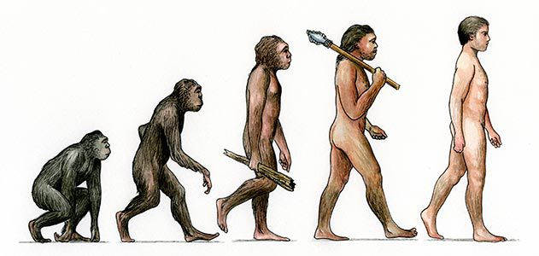

Slide 6
Definition: A representation scheme for a set of objects $𝒪$ is a one to one function $E:𝒪→\{0,1\}^{∗}$

Slide 7
Definition: A representation scheme for a set of objects $𝒪$ is a one to one function $E:𝒪→\{0,1\}^{∗}$
Equivalently: There is $D:\{0,1\}^{∗}→𝒪$ s.t. $D\left(E\left(x\right)\right)=x$ for every $x∈𝒪$

Slide 8
Definition: A representation scheme for a set of objects $𝒪$ is a one to one function $E:𝒪→\{0,1\}^{∗}$
Equivalently: There is $D:\{0,1\}^{∗}→𝒪$ s.t. $D\left(E\left(x\right)\right)=x$ for every $x∈𝒪$
Much research on “good” representations:
Effectiveness: Can compute encoding and decoding
Compression: Representation with small size (e.g., JPEG)
Error correction: Representation that is robust to errors (e.g., “control digits”, error correcting codes)
Data structures: Representation enabling fast operations (e.g., binary numbers, distance oracles)
Feature extraction: Representation enabling prediction (e.g., deep nets)
Secrecy: Representation hiding certain information (e.g., encryption)
Today: Simple representations for standard objects.

Slide 9
Binary representation
One to one function $E:ℕ→\{0,1\}^{∗}$
$E\left(83\right)=$
$$64$$ | $$32$$ | $$16$$ | $$8$$ | $$4$$ | $$2$$ | $$1$$
$$E\left(17\right)=$$
$$16$$ | $$8$$ | $$4$$ | $$2$$ | $$1$$

Slide 10
Binary representation
$$n$$ | $$E(n)$$
$$2$$ | $$10$$
$$4$$ | $$100$$
$$6$$ | $$110$$
$$0$$ | $$0$$
$$1$$ | $$1$$
One to one function $E:ℕ→\{0,1\}^{∗}$
$$E\left(83\right)=1010011$$
$$64$$ | $$32$$ | $$16$$ | $$8$$ | $$4$$ | $$2$$ | $$1$$
$$1$$ | $$0$$ | $$1$$ | $$0$$ | $$0$$ | $$1$$ | $$1$$
$$E\left(17\right)=10001$$
“I always work
in base 10.”
$$16$$ | $$8$$ | $$4$$ | $$2$$ | $$1$$
$$1$$ | $$0$$ | $$0$$ | $$0$$ | $$1$$

Slide 11
Exercise 1:
Give a representation of ${\left[3\right]}^{∗}={\left\{0,1,2\right\}}^{∗}$ as binary strings.
Specifically give the encoding function
“Prove” it is one-to-one (or give decoder)
Give an upper bound on the ratio $\frac{\left|E\left(x\right)\right|}{\left|x\right|}$ of your representation
Now improve the ratio!

Slide 15
Representing rational numbers
Lemma: There is a one to one function $E:\{0,1\}^{∗}×\{0,1\}^{∗}→\{0,1\}^{∗}$
$$x,x′$$
$$y$$
$$E$$
$E$ encodes a pair of strings as a single string.
What about $E\left(xx′\right)=xx′$?
(You) Will prove lemma shortly!
Corollary: Can represent $ℕ×ℕ$ as strings.
Corollary: Can represent rational numbers as strings.

Slide 16
Proof of Corollary:
Lemma: There is a one to one function $E:\{0,1\}^{∗}×\{0,1\}^{∗}→\{0,1\}^{∗}$
Corollary: Can represent $ℕ×ℕ$ as strings.

Slide 17
Prefix freeness
Definition: $E:𝒪→\{0,1\}^{∗}$ is prefix free if for every $x≠x′$, $E(x)$ is not prefix of $E(x^{′})$
$$1$$ | $$0$$ | $$1$$
Example: $101$ is prefix of $1010011$
$$1$$ | $$0$$ | $$1$$ | $$0$$ | $$0$$ | $$1$$ | $$1$$
English is not prefix free: teacherstalking.com

Slide 18
Prefix freeness
Definition: $E:𝒪→\{0,1\}^{∗}$ is prefix free if $∀ x≠x′$, $E(x)$ is not prefix of $E(x^{′})$
Theorem (2.18): “If $E$ is prefix free then we can use it to encode pairs/lists” $E$ prefix free $⇒$ $E^{′}:𝒪^{∗}→\{0,1\}^{∗}$ defined as $E^{′}\left(x^{0},x^{1},…,x^{n}\right)=E\left(x^{0}\right)E\left(x^{1}\right)…E\left(x^{n}\right)$ is one to one
Lemma (2.20): “Every encoding can be converted into a prefix-free one” If $E:𝒪→\{0,1\}^{∗}$, then there exists prefix-free one-to-one $E^{′}:𝒪→\{0,1\}^{∗}$
lists of numbers
lists of lists of numbers = matrices
Lists of lists of images = videos
…
numbers
images

Slide 19
Exercise 2:
Give a prefix free mapping: $E:{\left\{0,1\right\}}^{∗}→{\left\{0,1\right\}}^{∗}$
Hint (example): $0010100↦0010100\#$
Give an upper bound on the ratio $\frac{\left|E\left(x\right)\right|}{\left|x\right|}$ for your $E$.
(If you have extra time, try to think of $E$’s that improve the ratio.)

Slide 23
E.g., Representing Graphs
$G=\left(V,E\right);$ $V=[n]$ ; $E⊆V×V$

Slide 24
Example: Representing Matrix
$M∈ℤ^{n×m}$:
First represent “list”
Then represent “list of lists”

Slide 25
Prefix-free encoding in practice
“C style strings”: null terminated
“Pascal style”: encode $x∈\{0,1\}^{≤255}$ as $\left|x\right|,x$
..both led to many security breaks

Slide 26
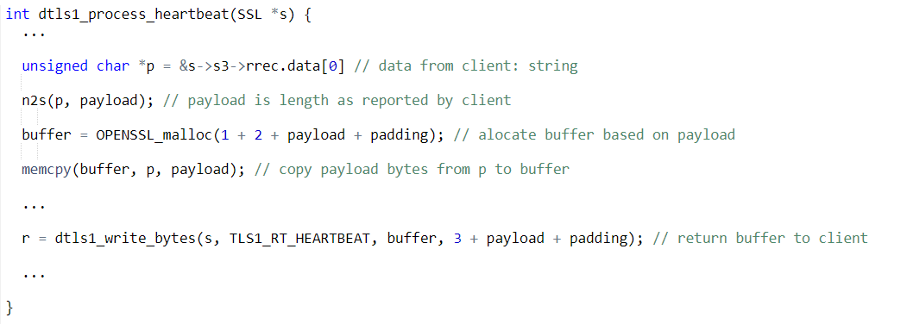
TLS Heartbeat protocol
$$\left|x\right|,x$$
Check connection is alive:
$$\left|x\right|,x$$

Slide 27
Heartbleed attack
“Some might argue that it is the worst vulnerability found (at least in terms of its potential impact) since commercial traffic began to flow on the Internet.”, Joseph Steinberg , Forbes.

Slide 28
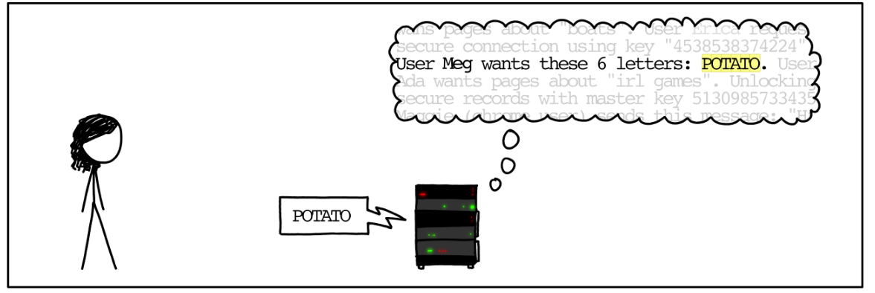
Heartbleed attack

Slide 29
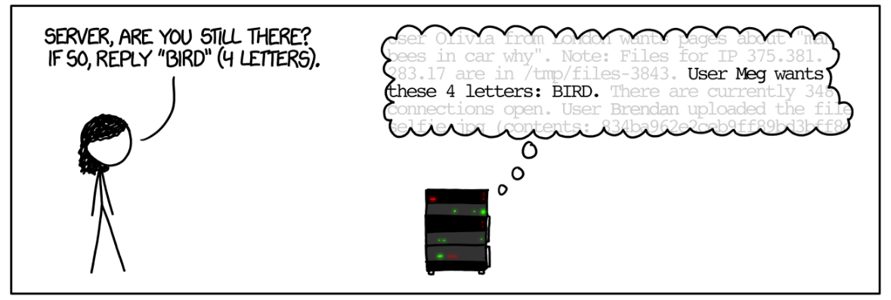
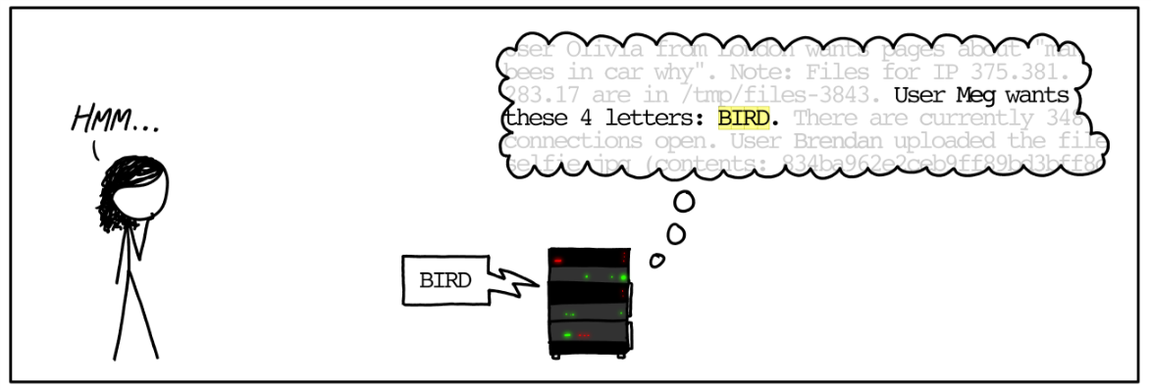
Heartbleed attack

Slide 30
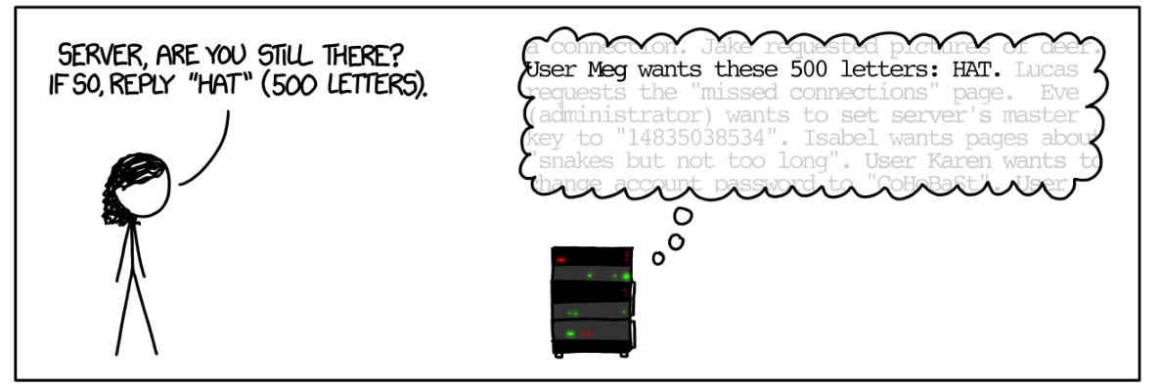
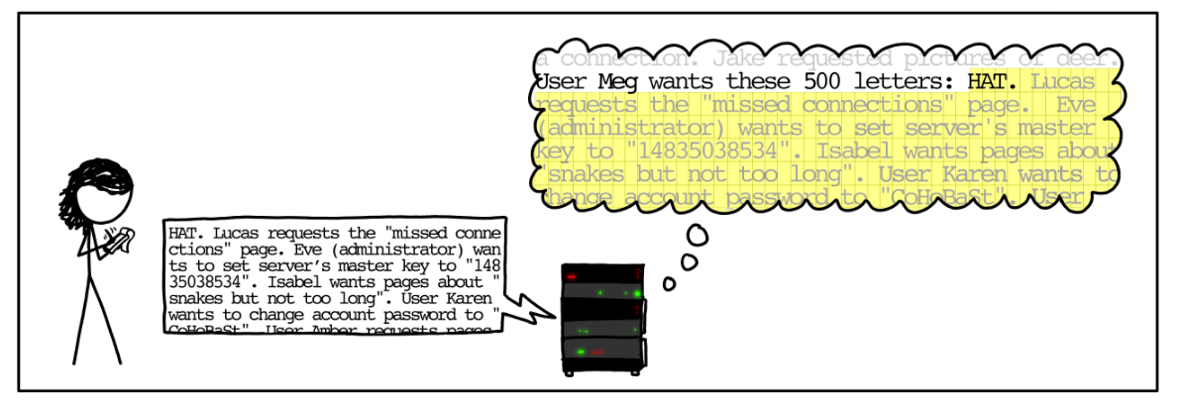
Heartbleed attack

Slide 31
Heartbleed attack

Slide 32
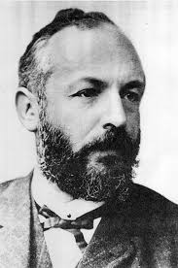
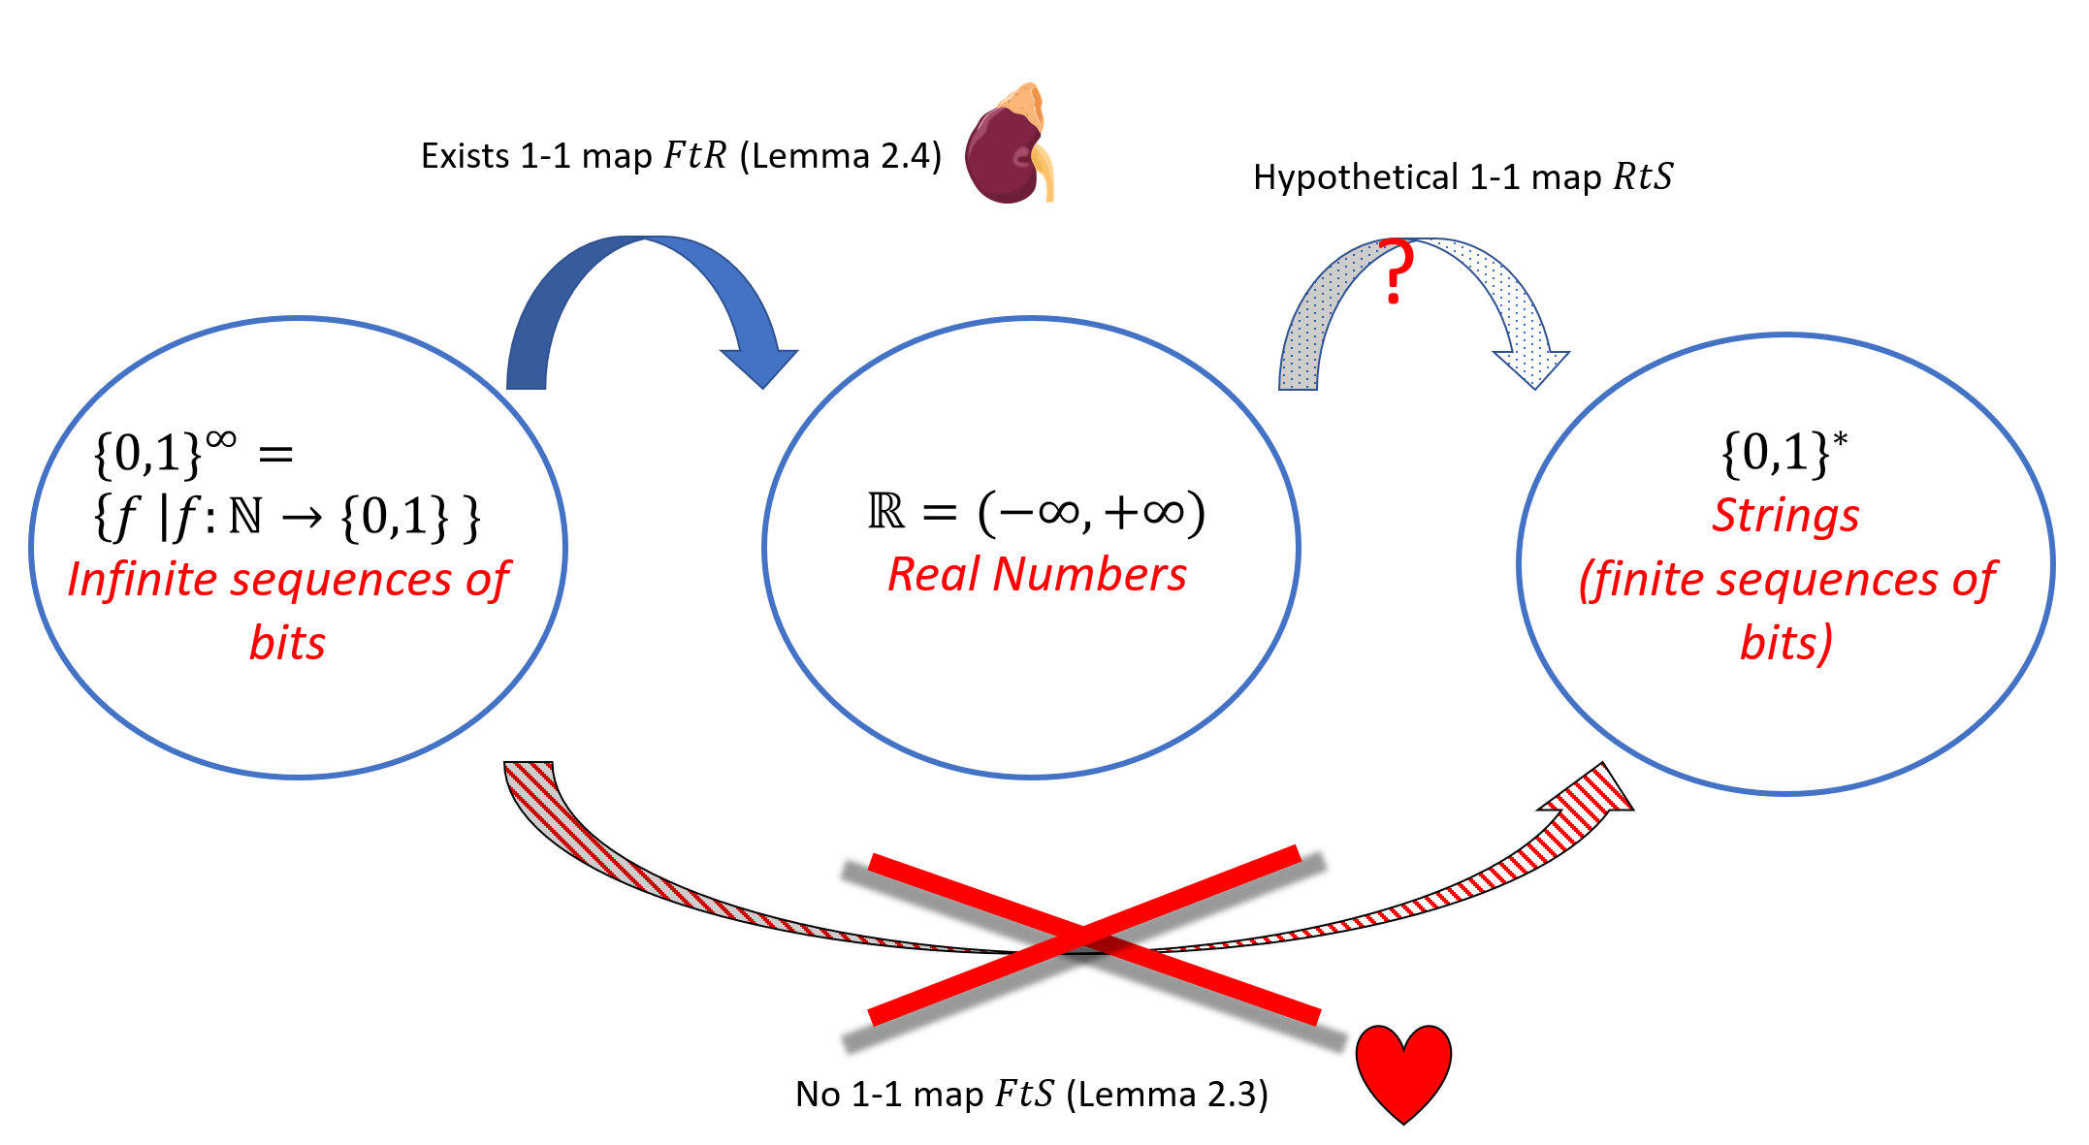
Can we represent everything?
Unfortunate Fact (Thm 2.5): “Can’t represent real numbers as strings” There is no one-to-one function $RtS:ℝ→\{0,1\}^{∗}$

Slide 33
Implications
Thesis: Everything representable as ${\left\{0,1\right\}}^{∗}$ !
Everything = $ℤ^{∗}$
Or Everything = ${\left\{0,1\right\}}^{∗}$
Or Everything = ${\left\{Keyboard\right\}}^{∗}$
Includes Music? All sounds? All images?
All Smell? People (“Beam me up, Scotty!”)

Slide 34
Rest of the course:
Part I: Circuits:
Finite computation,
quantitative study
Part II: Automata:
Infinite restricted computation, quantitative study
Part III: Turing Machines:
Infinite computation, qualitative study
Part IV: Efficient Computation:
Infinite computation, quantitative study
Part V: Randomized computation:
Extending studies to non-classical algorithms

