Slide 1
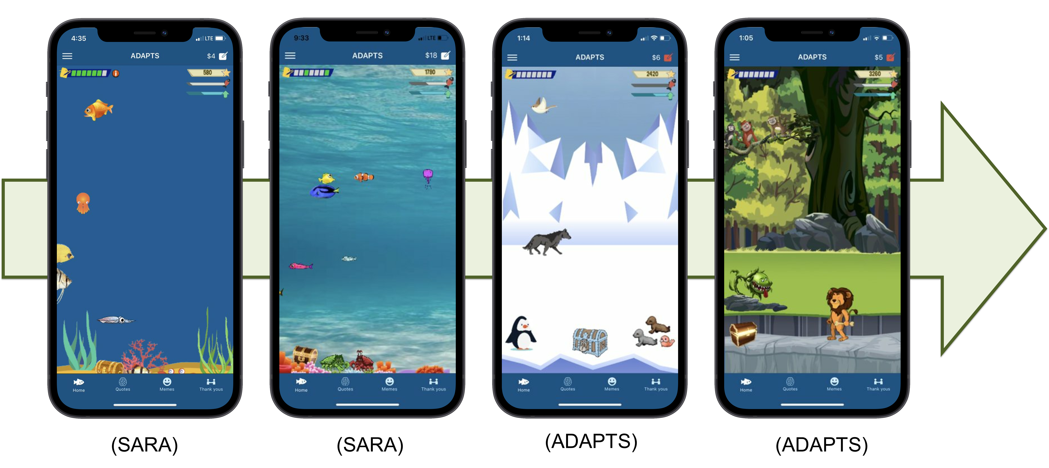
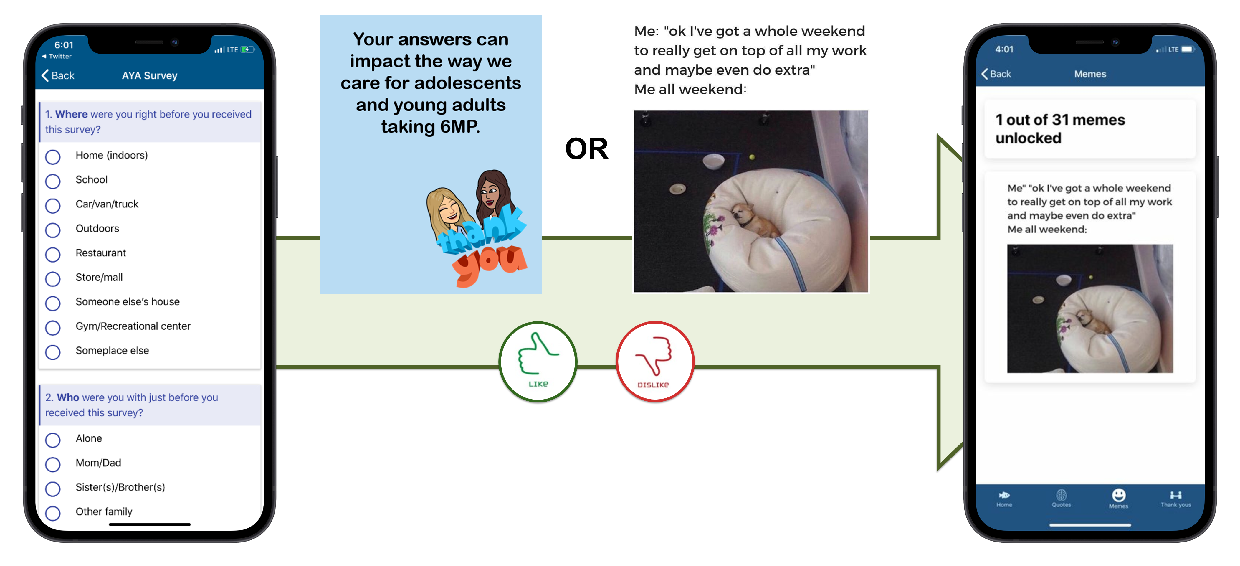
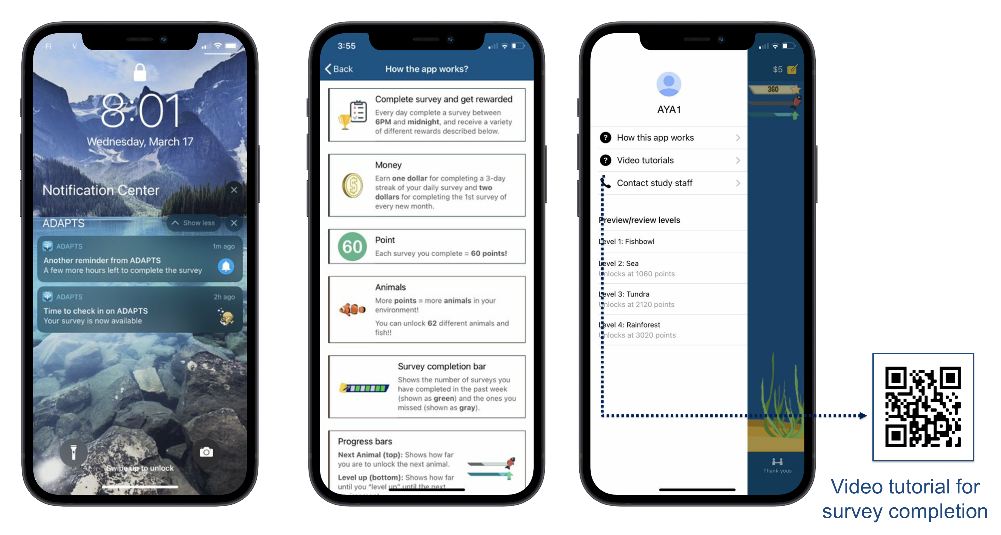
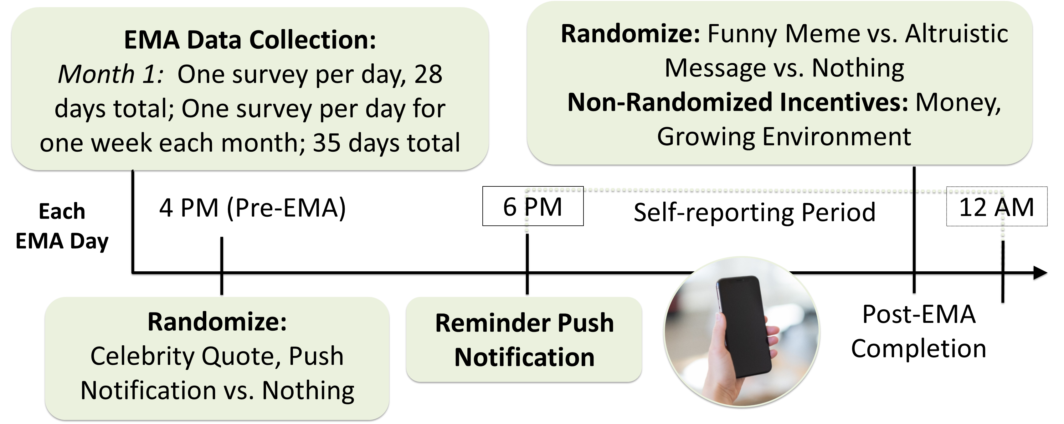
Iterative Refinement of an Open-Source Ecological Momentary Assessment App for Adolescents and Young Adults with Cancer
Annisa M. Ahmed, B.A.¹, Mashfiqui Rabbi, Ph.D.², Elise McKelvey, M.A.^{1,3}, Liying Huang, Ph.D.⁴, Linda Fleisher, Ph.D.⁵, Lisa A. Schwartz, Ph.D.^{1,6},
Lamia P. Barakat, Ph.D.^{1,6}, Susan A. Murphy, Ph.D.², & Alexandra M. Psihogios, Ph.D.^{1,6}
¹The Children’s Hospital of Philadelphia, ²Harvard University, ³La Salle University, ⁴Pennsylvania State University, ⁵Fox Chase Cancer Center, ⁶University of Pennsylvania Perelman School of Medicine
INTRODUCTION
Adolescents and young adults (AYA) with cancer demonstrate suboptimal medication adherence, which can negatively impact the efficacy of their treatment
Little is known how contextual time-varying variables impact daily oral chemotherapy adherence
Ecological momentary assessment (EMA) involves recurring surveys of behaviors/experiences in real time, and is uniquely equipped to address this gap
Objective: To illustrate the iterative refinement of an existing EMA app—“SARA,” originally developed for AYA at-risk for substance abuse and designed to incentivize engagement—for AYA with cancer (“ADAPTS”)
DEVELOPMENT OF ADAPTS
RESULTS
Stage 1 Results (Stakeholder Needs/Feedback)
Expanded the virtual environment to accommodate a longer EMA period by adding new levels
Added a new engagement feature that reminds participants that their EMA responses will benefit others (altruistic messages)
Updated memes/quotes to be contemporary and narrow to the most highly rated
Selected 66 memes and 100 quotes from social media/web, vetted by stakeholders on a 4-point rating scale and retain the most highly rated (31 memes and 72 quotes; M > 3.2 )
Developed a parallel caregiver version
Stage 2 Results (Internal Pilot)
Fixed technical issues (e.g., offline survey submission error, back button survey bug)
Accommodated suggestions for improving app functionality (e.g., storing previously received incentives in a feed, adding educational content that clarified the app’s functionality)
Stage 3 Results (Pilot Test with End Users)
Discovered and resolved additional technical issues (e.g., notification glitch, money glitch),
AYA expressed satisfaction with the content and showed high completion rates on average (M=79%, Range=34%-100%)
METHODS
SARA is an open-source EMA app that delivers 30-days of surveys and micro-randomizes various engagement strategies (e.g., memes, quotes)
Informed by user-centered design and agile science principles, the refinement of SARA for AYA with cancer involved 3 stages over 8 months:
1) Multi-disciplinary team meetings to identify necessary app modifications, then selecting and vetting new engagement content with AYA with and without cancer, and oncology research staff (n=33 responses)
2) 1-month internal pilot test with behavioral oncology research staff (e.g., faculty, post-docs; n=8)
3) 1-month pilot with end user AYA with cancer (n=10, M age=16.5)
App was expanded with two additional environments (Stage 1)
Incorporated contemporary/highly rated memes/celebrity quotes, added altruistic message reward (Stage 1);
Added a feed for all earned content (Stage 2)
DISCUSSION
Our rapid, iterative development process led to a more functional and appealing app
Refining an open-source EMA app had many advantages (i.e., generalizability, low cost, lessons learned from the initial trial)
We are now enrolling participants and will discuss our protocol for micro-randomizing engagement features (see Figure 1)
Figure 1. Micro-Randomized Procedures for ADAPTS
Included an extra 8 PM EMA reminder, added features that clarify the app’s functionality (Stage 2)
This study was funded by the National Cancer Institute (K08CA241335; PI: Psihogios)
Notes:
https://www.qrcode-monkey.com/)
Use this to make a QR code for poster
Table 4. Binary Logistic Regression for Medication Adherence over the Past Week
References used:
Kennard et al., 2004
Bleyer et al., 2002
Wu et al., 2018
Zelikovsky & Schast, 2008

