Slide 1




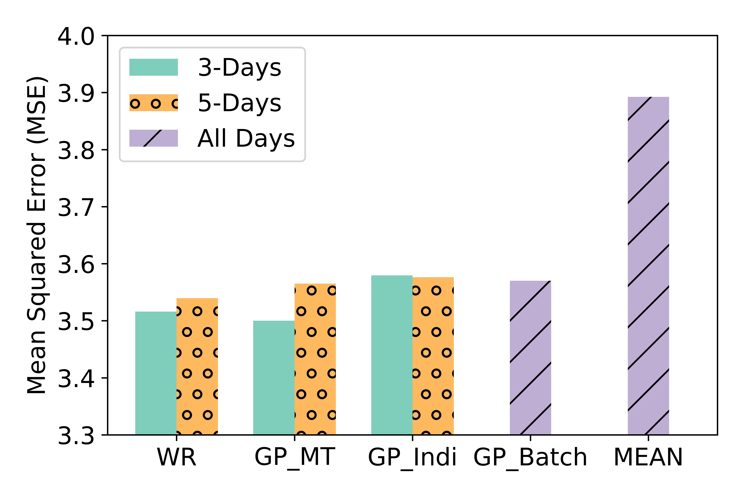
Personalizing Intervention Probabilities By Pooling
Sabina Tomkins¹, Predrag Klasnja², Susan Murphy¹
Harvard University¹, University of Michigan²
Goal - determine how many times target context will occur
Intervene probabilistically – where p ~ budget / remaining number of sedentary periods
People are different – we want personalized methods
Not enough data to do quickly
Two forms of pooling
Multi-task Gaussian Process
Weighted regressors
Exploit similarities between people
Pooling helps – results vary with training windows

