Slide 1



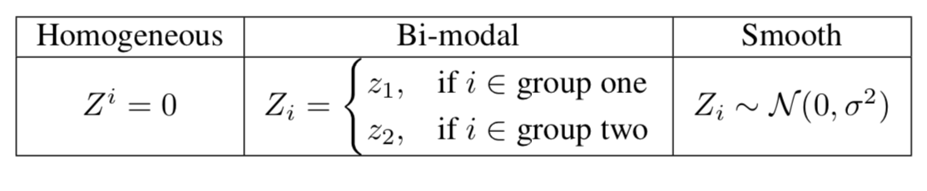

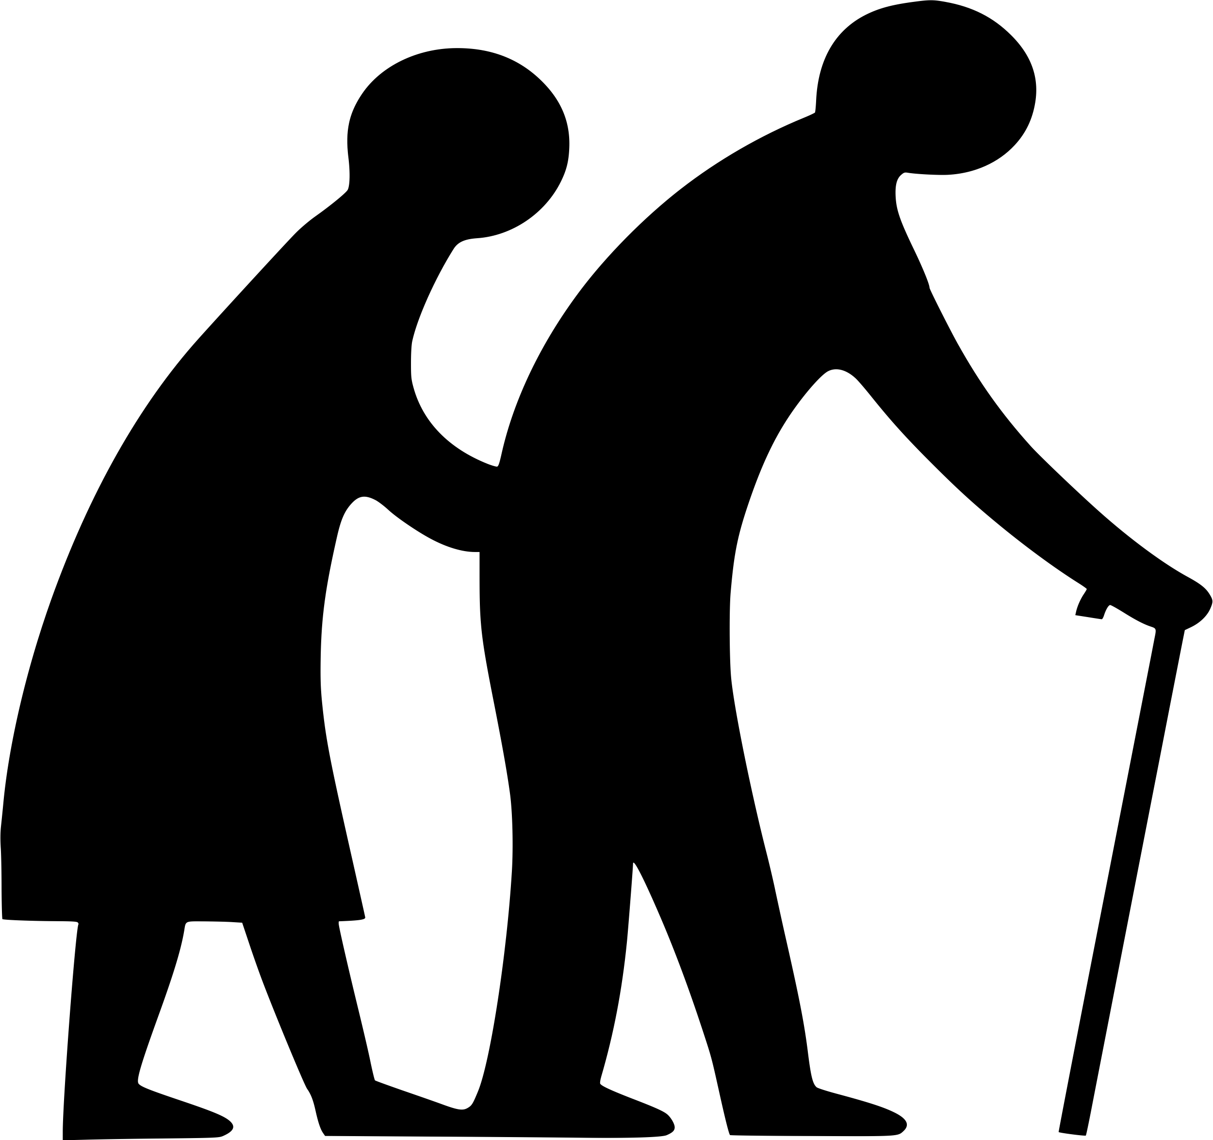








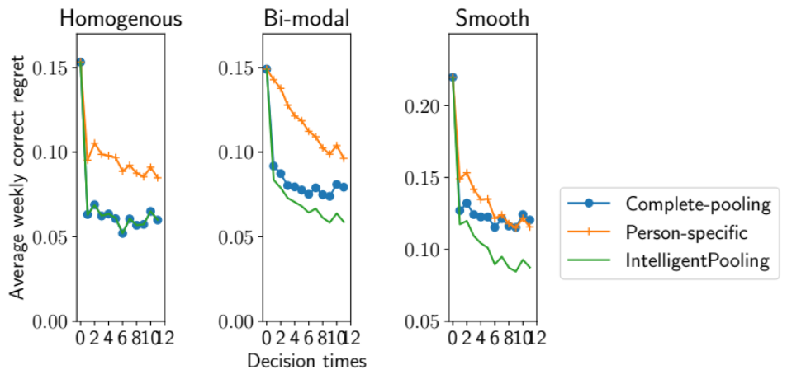
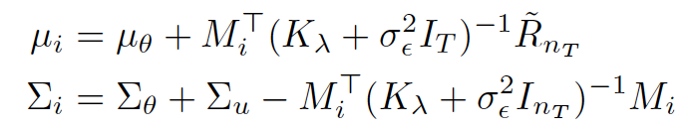




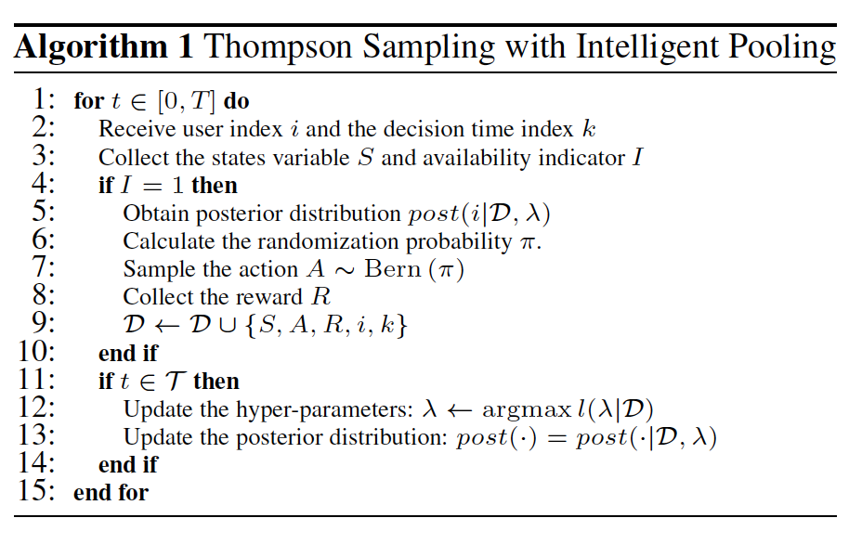




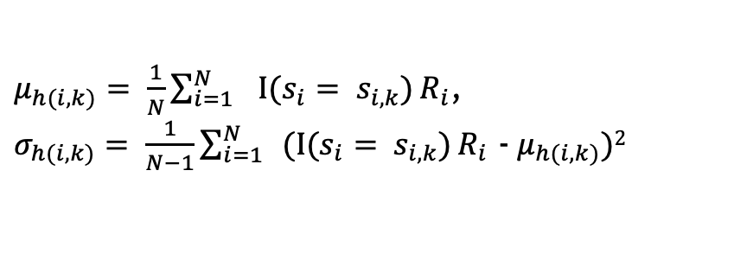
Intelligent Thompson Sampling:
Rapid Personalization for Mobile Health
Sabina Tomkins, Peng Liao, Serena Yeung, Predrag Klasnja, Susan Murphy
Motivation
Intelligent
Thompson Sampling
Real-life
physical activity study
Population varieties
Provide smartphone-based just in time, adaptive behavioral interventions (JITAI) to increase physical activity
Two messages: anti-sedentary & walking suggestion
delivered on phone
participants wore Fitbit
Population
36 participants
Enrolled for ~7 weeks
Collected: step counts, temperature, location, surveys
Everyone the same, two groups, smoothly varying individuals
Personalized
policy
Baselines
User
Bayesian random effects model
Simulation
Person-specific: Separately learn each persons policy
Complete-pooling: Learn one policy for all people
Goal: Learn an optimal intervention policy for each user
Population term
User effect
Generate states from historical data
Induces a covariance structure
Study
Contextual bandit
Participants
Results
Linear bandit posterior mean & covariance
Base activity level
Study
length
Consider a two-armed bandit
Prior mean & variance
Mean centered reward
Evolving Environment
Linear model of the reward [Agrawal et al 2013]
Kernel output between all pairs of tuples in dataset
Residual
variance
Evolving user states
Treatment probability determined by Bayesian posterior of reward function
Location
Availability
Previous activity level
?
Take-aways
As participants vary complete pooling suffers
Person-specific methods learn slowly
Pooling combines best of both worlds
Advances state-of-the-art in mobile health: rapid learning of personal parameters – goes beyond tailoring
Generating step counts (reward)
User index i
Action
Linear model coefficients of context and reward
Personalization trade-off
$μ_{h(i,k)}= \frac{1}{N}\sum_{{i=1}_{}}^{N}{Ι(s_{i}= s_{i,k})}R_{i}$,
$σ_{h(i,k)}= \frac{1}{N−1}\sum_{{i=1}_{}}^{N}{(Ι(s_{i}= s_{i,k})}R_{i}$ - $μ_{h(i,k)})2$
Acknowledgement
Personalized
policies
Rapid
policy learning
With Empirical Bayes
This material is based upon work supported by the NIH/NIAAA grant R01AA23187, NIH/NIDA grant P50DA039838
& NIH/NCI grant U01CA229437
Personalized
policies
Rapid
policy learning
Intelligent pooling

